Slide 1
Tutorial 03

Slide 2
Outline
Aggregation
Weak Entity Sets
Generalization and Specialization
Aggregation
Aggregation is an abstraction through which we can represent relationships as higher level entity sets.
Weak Entity Sets
Generalization and Specialization

Slide 3
Aggregation
Aggregation
Weak Entity Sets
Generalization and Specialization
A better model is let “student”, “instructor”, “course”, and “enroll” form an abstract entity as an aggregation.
Then “project” only need to associate with the courses which has a course project.
instructor
student
enroll
course
doing
project

Slide 4
Weak Entity Sets
Aggregation
Weak Entity Sets
Generalization and Specialization
A weak entity is an entity cannot exist alone. The existence depends on another entity of a different type.
A set of weak entities is a weak entity set.
Since a weak entity cannot exist alone, it does not have a key.
The existence of a weak entity set depends on the existence of an identifying entity set.
A weak must relate to the identifying entity set via a total, one-to-many relationship set from the identifying to the weak entity set.
An identifying relationship depicted using a double diamond.
The discriminator (or partial key) of a weak entity set is the set of attributes that distinguishes among all the entities of a weak entity set.
To distinguish weak entities, one must combine the key of the identifying entity set and the discriminator.

Slide 5
Weak Entity Sets
Aggregation
Weak Entity Sets
Generalization and Specialization
The existence of a weak entity set depends on the existence of an identifying entity set.
A weak must relate to the identifying entity set via a total, one-to-many relationship set from the identifying to the weak entity set.
An identifying relationship depicted using a double diamond.
The discriminator (or partial key) of a weak entity set is the set of attributes that distinguishes among all the entities of a weak entity set.
To distinguish weak entities, one must combine the key of the identifying entity set and the discriminator.
student
enroll
section
course_section
section_num
instructor
course
COMP 3013
section 1004

Slide 6
Weak Entity Sets
Aggregation
Weak Entity Sets
Generalization and Specialization
Double rectangles denote weak entity sets.
Dashed underlines denote discriminators of weak entity sets.
Double diamonds denote identifying relationship sets.
Assume we model the original “enroll” relationship set without constraints.
After adding the weak entity set “section”,
student
enroll
section
course_section
section_num
instructor
course

Slide 7
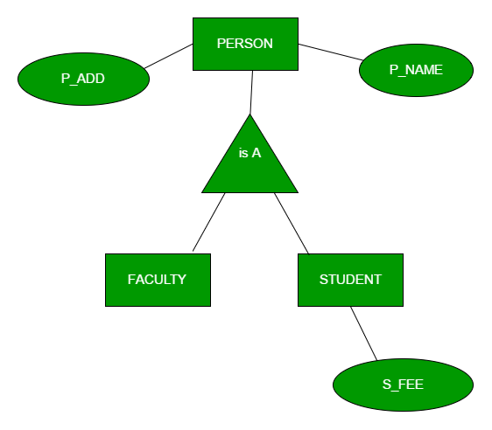
Generalization and Specialization
Aggregation
Weak Entity Sets
Generalization and Specialization
Generalization is the process of extracting common properties from a set of entities and create a generalized entity from it. It is a bottom-up approach in which two or more entities can be generalized to a higher level entity if they have some attributes in common.

Slide 8
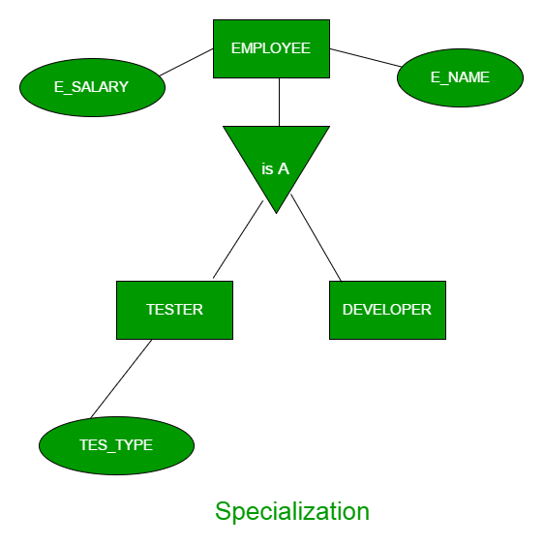
Generalization and Specialization
Aggregation
Weak Entity Sets
Generalization and Specialization
In specialization, an entity is divided into sub-entities based on their characteristics. It is a top-down approach where higher level entity is specialized into two or more lower level entities.

Slide 9
Constraints on Generalization/Specialization
Aggregation
Weak Entity Sets
Generalization and Specialization
Cardinality constraints and participation constraints can be applied on ISA relationship sets.
But some constraints are omitted because
each entity on the lower-level is one entity on the higher-level (the entity sets on the lower-level always fully participate ISA);
one entity cannot be associated with multiple entities in the same entity set on the lower-level.
Thus, the constraints on ISA only discuss
Does one higher-level entity belong to at least one lower-level entity set?
If yes, this ISA is a total generalization.
Does one higher-level entity belong to multiple lower-level entity set?
If No, it is a disjoint generalization.

Slide 10
Lab.

Slide 11
Motivation
Are you tired of condition checking in cross table queries?
The NATURAL JOIN operator associates two tables by the common attributes.
After NATURAL JOIN, the duplicated attributes are omitted.

Slide 12
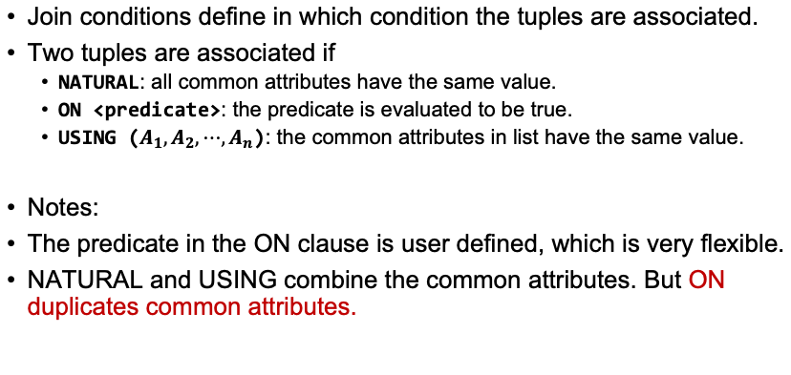
Join Condition
Join conditions define in which condition the tuples are associated.
Two tuples are associated if
NATURAL: all common attributes have the same value.
ON <predicate>: the predicate is evaluated to be true.
USING ($A_{1},A_{2},⋯,A_{n}$): the common attributes in list have the same value.
Notes:
The predicate in the ON clause is user defined, which is very flexible.
NATURAL and USING combine the common attributes. But ON duplicates common attributes.

Slide 13
Join Condition
A JOIN without any condition is same as a cartesian product.

Slide 14
Join Type
Sometimes users want to keep the unmatched tuples after joining two tables.
OUTER JOIN can handle it.
table1 NATURAL LEFT OUTER JOIN table2
All tuples in table1 are in the result. For the unmatched tuples, the values of the attributes from table2 are NULL, meaning “unknown”. (NULL values will be introduced in following labs.)
table1 NATURAL RIGHT OUTER JOIN table2
The unmatched tuples from table2 are kept.
table1 NATURAL FULL OUTER JOIN table2
All tuples (from both table1 and table2) are kept.
NATURAL is the join condition.
On the opposite of OUTER, INNER JOIN does not keep the unmatched tuples.
Same as JOIN. “INNER” is usually omitted.

Slide 15
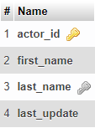
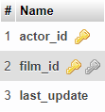
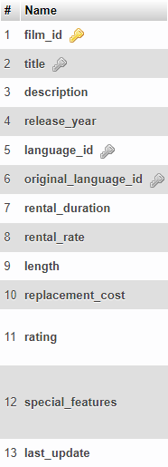
1.Find the films (title) played by Zero Cage.
Table: actor
Table: film_actor
Table: film
SELECT title
FROM film
JOIN film_actor USING (film_id)
JOIN actor USING (actor_id)
WHERE first_name='Zero' AND last_name='Cage’
Attributes film_id and actor_id have same value in the joined tables

Slide 16
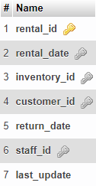
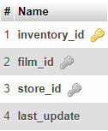
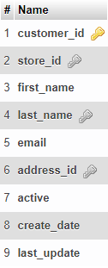
2.Find the films (title) rented by George Linton. The join condition is ON.
Table: rental
Table: inventory
Table: film
SELECT title
FROM customer
JOIN rental
ON customer.customer_id=rental.customer_id
JOIN inventory
ON rental.inventory_id=inventory.inventory_id
JOIN film
ON inventory.film_id=film.film_id
WHERE first_name='George' AND last_name='Linton'
Table: customer
“George”
“Linton”

Slide 17
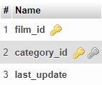
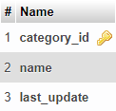
3.Find the customers (name) who have rented some action (category) films. The join condition is USING.
Table: customer
Table: rental
Table: inventory
Table: film_category
Table: category
“action”
SELECT first_name, last_name
FROM customer
JOIN rental USING(customer_id)
JOIN inventory USING(inventory_id)
JOIN film_category USING(film_id)
JOIN category USING(category_id)
WHERE name='Action'

Slide 18
4.Join the tables film, film_category, and category, using both conditions ON and USING.
SELECT *
FROM film JOIN film_category USING(film_id) JOIN category ON(film_category.category_id=category.category_id)

Slide 19
4.Join the tables film, film_category, and category, using both conditions ON and USING.
Table: film
Table: film_category
Table: category
SELECT *
FROM film
JOIN film_category USING(film_id)
JOIN category ON(film_category.category_id=category.category_id)

Slide 20
5.Find all pairs of customers (name) who have rented a same film. Any join condition is fine.
SELECT c1.first_name,c1.last_name, c2.first_name, c2.last_name
FROM inventory AS i1 JOIN inventory AS i2 ON i1.inventory_id<>i2.inventory_id AND i1.film_id=i2.film_id JOIN rental AS r1 ON i1.inventory_id=r1.inventory_id JOIN rental AS r2 ON i2.inventory_id=r2.inventory_id JOIN customer AS c1 ON r1.customer_id=c1.customer_id JOIN customer AS c2 ON r2.customer_id=c2.customer_id;

Slide 21
5.Find all pairs of customers (name) who have rented a same film. Any join condition is fine.
Table: customer
Table: rental
Table: inventory
SELECT customer_id, first_name, last_name, film_id
from customer join rental using(customer_id)
join inventory using(inventory_id)
Table: customer
Table: rental
Table: inventory
SELECT customer_id, first_name, last_name, film_id
from customer join rental using(customer_id)
join inventory using(inventory_id)

Slide 22
5.Find all pairs of customers (name) who have rented a same film. Any join condition is fine.
Table: customer
Table: rental
Table: inventory
select t1.first_name, t1.last_name, t2.first_name, t2.last_name
from (
SELECT customer_id, first_name, last_name, film_id
from customer join rental using(customer_id)
join inventory using(inventory_id)
) as t1,
(
SELECT customer_id, first_name, last_name, film_id
from customer join rental using(customer_id)
join inventory using(inventory_id)
) as t2
where
t1.customer_id <> t2.customer_id
and t1.film_id = t2.film_id
Table: customer
Table: rental
Table: inventory

Slide 23
5.Find all pairs of customers (name) who have rented a same film. Any join condition is fine.
Table: customer as c1
Table: rental as r1
Table: inventory as i1, i2
SELECT c1.first_name,c1.last_name,
c2.first_name, c2.last_name
FROM inventory AS i1
JOIN inventory AS i2
ON (
i1.inventory_id<>i2.inventory_id
AND
i1.film_id=i2.film_id
)
JOIN rental AS r1 ON i1.inventory_id=r1.inventory_id
JOIN rental AS r2 ON i2.inventory_id=r2.inventory_id
JOIN customer AS c1 ON r1.customer_id=c1.customer_id
JOIN customer AS c2 ON r2.customer_id=c2.customer_id;
Table: customer as c2
Table: rental as r2

Slide 24
6.Find the films rented by each customer. If a customer has not rented any film, give it a NULL value.
Table: rental
Table: inventory
Table: film
SELECT first_name, last_name, title
FROM customer
LEFT OUTER JOIN rental USING(customer_id)
LEFT OUTER JOIN inventory USING(inventory_id)
LEFT OUTER JOIN film USING(film_id)
Table: customer

